Slide 1
Celgene Integration Batch 2 – Japan
Provide ES Amount with NHI Price
and Dealer Price

Slide 2
Provide ES Amount on the basis of NHI Price
Flow chart
Provide ES Amount with NHI Price and Dealer Price
Existing Process
Bridge
ES Data
L1
L2
ES Amount on the basis of NHI Price will flow into L3 from L2
L3
CSCOR/CSTAR/DEL
ETL Process
ES Amount will now be calculated as (NHI Price * Unit Price) by using NHI Price master from Bridge
Currently ES Amount is calculated as (Dealer Price X Quantity)
ETL Process: Merge Group Calls
Process of calculation of ES Amount
2

Slide 3
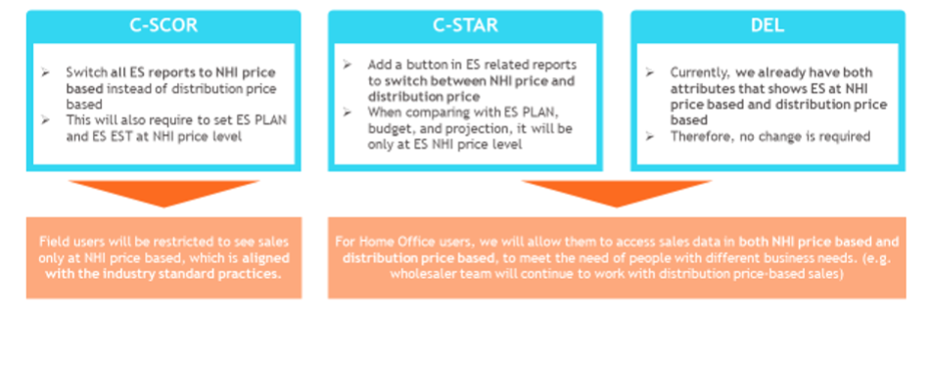
Summary of NHI price-based ES display change in CIRRUS related system and its impact to end-users
Provide ES Amount with NHI Price and Dealer Price
4

Slide 4
ES Amount Calculation in C-SCOR Reports
Provide ES Amount with NHI Price and Dealer Price
Report Name | Calculation of ES Amount
My Performance | ES Amount calculated on the basis Point-in-Time NHI Price
My Geography | ES Amount calculated on the basis Point-in-Time NHI Price
 | ES Amount calculated on the basis Latest NHI Price
Customer 360 Institution | ES Amount calculated on the basis Point-in-Time NHI Price
 | ES Amount calculated on the basis Latest NHI Price
My Customer Institution List | ES Amount calculated on the basis Point-in-Time NHI Price
ES KPI | ES Amount calculated on the basis Point-in-Time NHI Price
ES Trend | ES Amount calculated on the basis Point-in-Time NHI Price
 | ES Amount calculated on the basis Latest NHI Price
JDNet Detail & Summary | ES Amount calculated on the basis Point-in-Time NHI Price
ES Ranking; Have separate slide on this; | ES Amount calculated on the basis Point-in-Time NHI Price from 2021 onwards. ES Amount to remain same until 2020.
3

Slide 5
Calculation of EST and PLAN Sales
Provide ES Amount with NHI Price and Dealer Price
Metric Name | Calculation of ES Amount
Historical EST Sales(until 2020) | Sales won’t be updated with NHI Price
EST Sales – 2021 onwards | To be received from 2021 onwards and the same will flow in all C-SCAN layers. No logic to be applied in C-SCAN
Historical PLAN Sales | Bridge team will update(for 3 years; to be confirmed with business) and send ES Plan sales data
PLAN Sales – 2021 onwards | To be received from 2021 onwards and the same will flow in all C-SCAN layers. No logic to be applied in C-SCAN
Note:
In ES Ranking report, ES won’t be changed until 2020 which means historical ES data to be preserved. However to calculate %G for 2021, team would calculate ES for 2020 on the basis of PIT NHI price by using a temporary solution.
4

